Slide 1

Predicting the Price of Used Toyota Corolla Cars - using Multiple Linear Regression
Group-3
Aditya Singh Kashyap-02
Swastika Swastik-53

Slide 2
Why this dataset?
Link:-https://www.kaggle.com/klkwak/toyotacorollacsv
· A large Toyota car dealership offers purchasers the option to buy their used car as part of a trade-in.
Particularly, a new promotion promises to pay high prices for used Toyota Corolla cars for purchasers of a new car. The dealer then sells the used cars for a small profit.
To ensure a reasonable profit, the dealer needs to be able to predict the price that the dealership will get for the used cars. For that reason, data were collected on all previous sales of used Toyota Corollas at the dealership. The data include the sales price and other information on the car, such as its age, mileage, fuel type, and engine size.

Slide 3
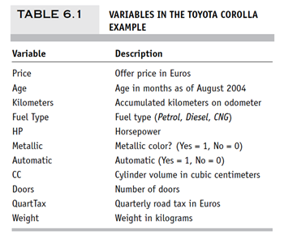
About the Data
Notes:
A description of each of these variables is given in Table 6.1.

Slide 4
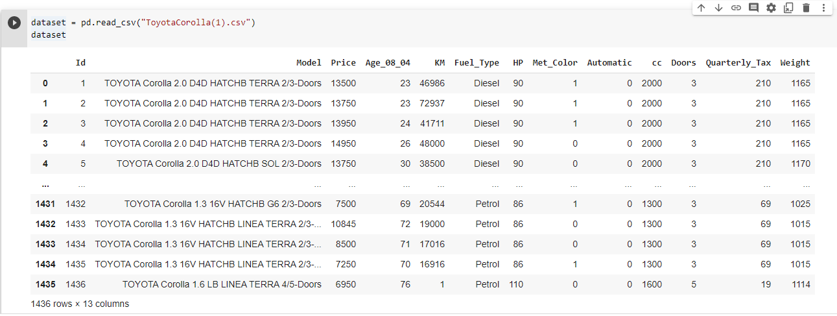
Data Pre processing
For our Toyota corolla Dataset, the Pre-Processing was performed on Python.

Slide 5
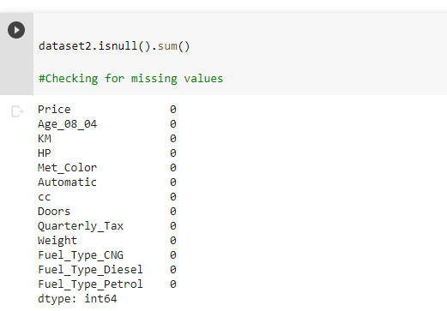
Checking for Missing Values

Slide 6
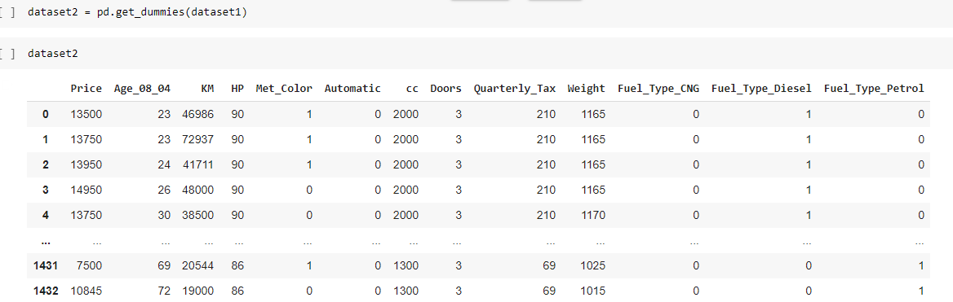
Creation of Dummy Variables

Slide 7
Exploratory Data Analysis
10
38
1
IndependentVariables
Attributes
Dependent Variable

Slide 8
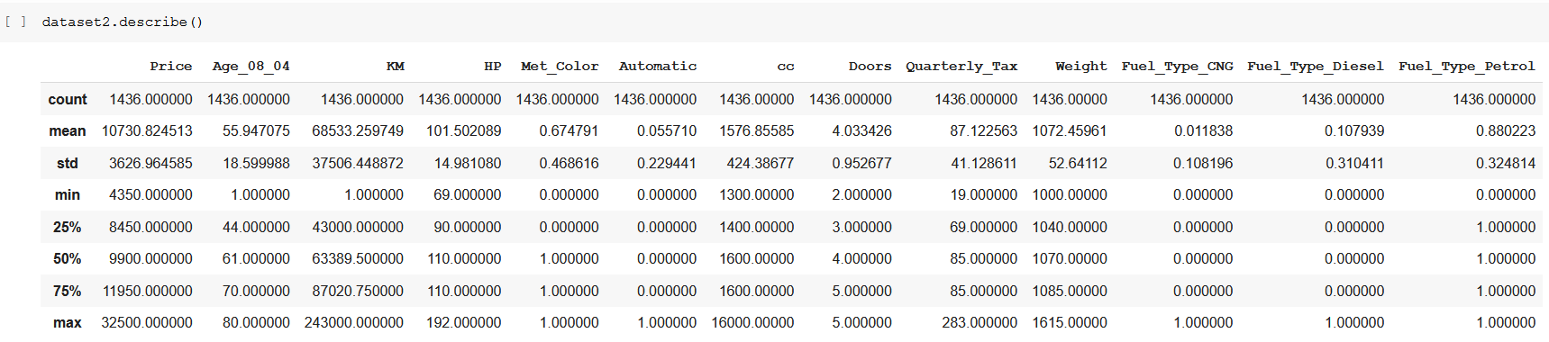
Descriptive Statistics

Slide 9
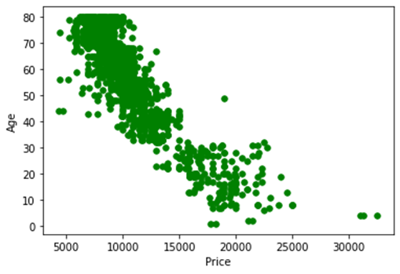
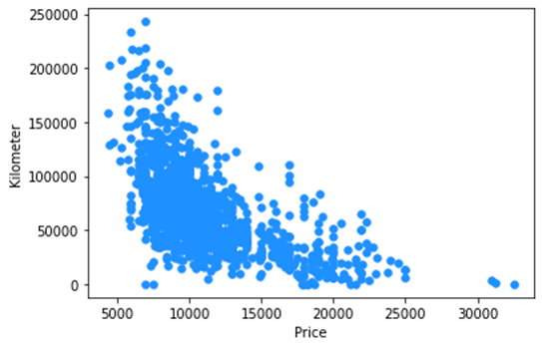
ScatterPlot Analysis
Notes:
Scatter Plot Age Vs Price

Slide 10
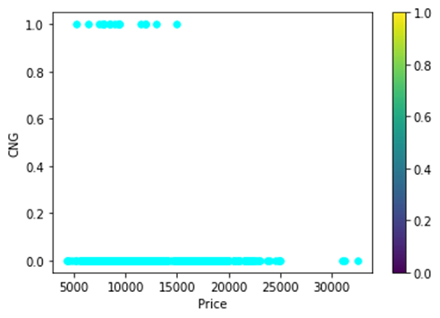
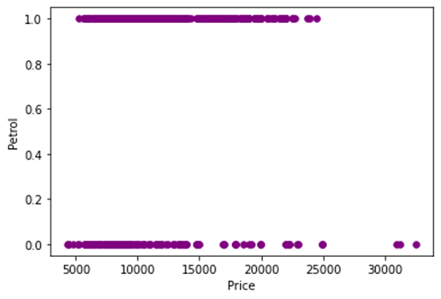
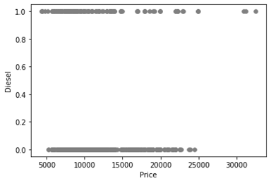

Slide 11
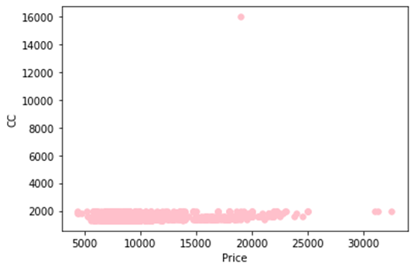
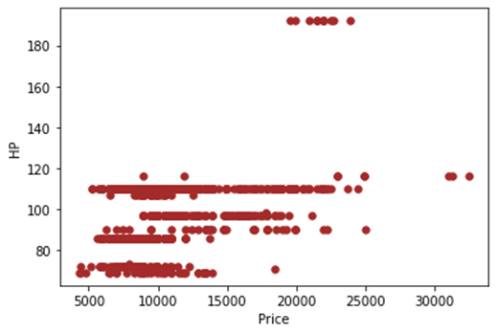

Slide 12
Explanation:-
The plot displays the data distribution of dependent variable:- Age, Kilometer, CC, Fuel types(CNG, Petrol, Diesel) with respect to the Price.
As observed in the above scatterplots, the minimal distribution of price above 30000, across all the graphs, is isolated from the general distribution of the explanatory variables.
Similarly, the small cluster of data points representing Horsepower above 180 and 16000cc are the outliers as well.
Removing these data points can result in slight improvement of our linear model.

Slide 13
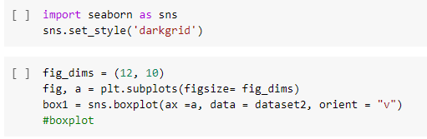
Boxplot
The Box Plot explains the distribution of data points according to each variable.

Slide 14
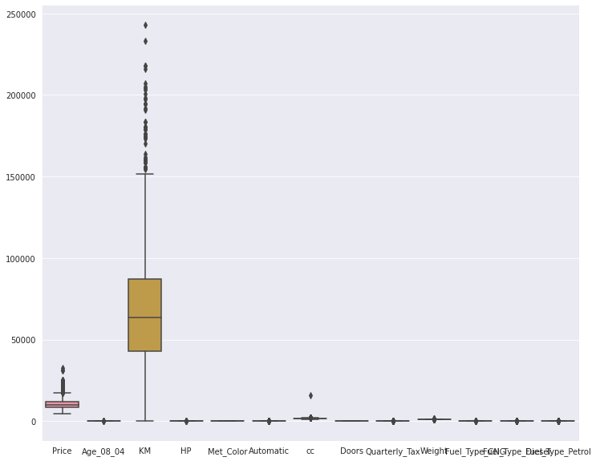
KM isolates near the 250,000 mark. CC isolates around 16000, as observed in the scatter plot.

Slide 15
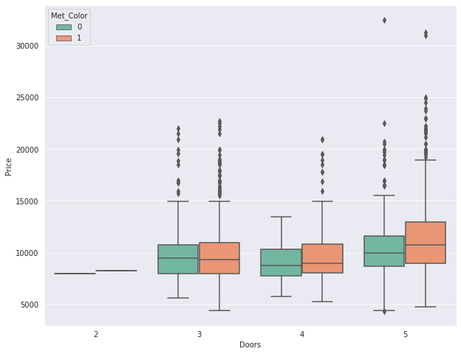
The pattern persists in this box plot too, where points of Price above 30000 are the potential outliers.

Slide 16
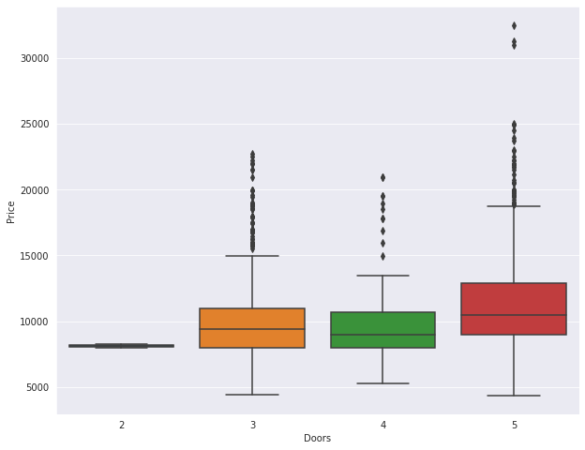
Data points of Price above 30000 and Cars with 5 doors are the outliers.

Slide 17
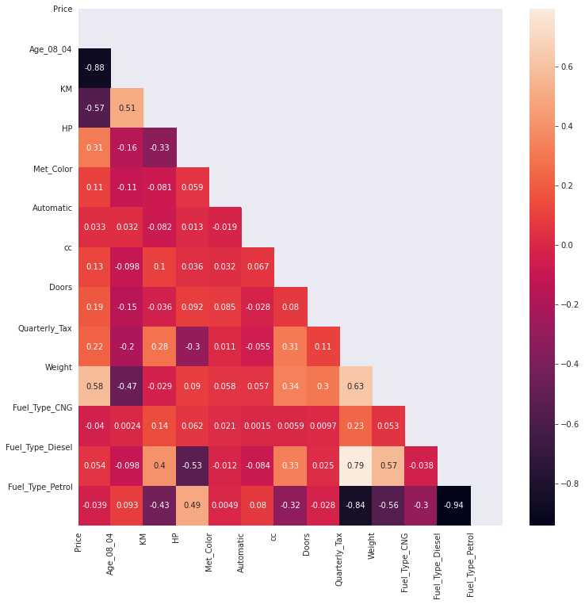
Correlation Analysis

Slide 18
The above Correlation plot depicts the relation between the variables.
As visible from the graph, Age and Price show very high negative Correlation, -0.88, meaning a strong inverse relationship exists between the two.
Quarterly Tax and Fuel Type Petrol strong negative correlation, -0.84. Quarterly Tax and Fuel Type Diesel show a high positive correlation, 0.79, meaning fuel type is a major factor in Quarterly Tax paid for a car.
Fuel Type Petrol and Diesel show a strong negative correlation, as Car runs on only one fuel.
The pattern is not visible in CNG as it can be installed on any automobile setup, irrespective of the fuel type.

Slide 19
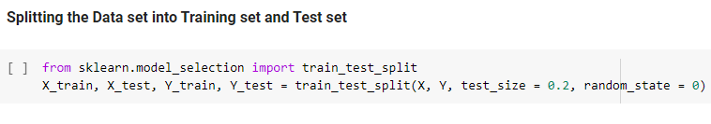
Model Building
Dataset was partitioned the data into training (80%) and test (20%) sets,.
The total number of records in the dataset is 1436 cars.

Slide 20
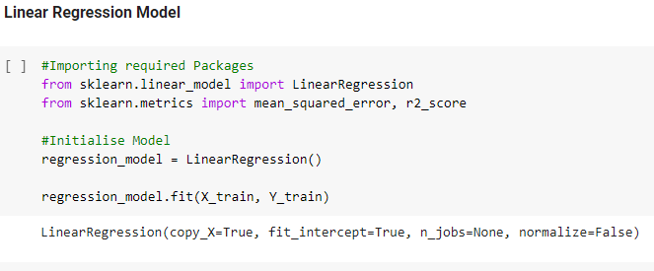
Algorithm Applied:- Multiple Linear Regression
All the Modelling is performed at 5% Level of Significance; α = 0.05
For our modelling, Python, sklearn.linear_model package

Slide 21
Hypothesis Formation:
H1₀: There is no relationship between Price and Independent Variables.
H1₁: There exists a relationship between Price and Independent Variable.
H2₀: There is no statistical significance between Price and Explanatory Variables
H2₁: There exists some statistical significance between Dependent Variables and Explanatory Variables and not all coefficients are Zero.

Slide 22
Interpretation:-
Since P-Value of all all variables, except Metallic Colour, Automatic, cc, Doors, and Fuel Type Petrol, are less than 0.05 for H1, we reject H1₀,
and except for mentioned variables, meaning there exists a relationship between independent and some dependent variables.
Since P-Value (0.000, from OLS Regression Stats) is less than 0.05 for H2, we reject H2₀, meaning our model is statistically significant.

Slide 23
Linear Equation
Price = --4732.4232 + -123.120*Age_08_04 - .017*KM +23.851*HP + 36.289*Met Color + 258.828*Automatic -.063*cc - 71.612*Doors + 12.313* Quarterly Tax + 19.357 - 627.975* Fuel_Type_CNG + 1792.336* Fuel_Type_Petrol

Slide 24
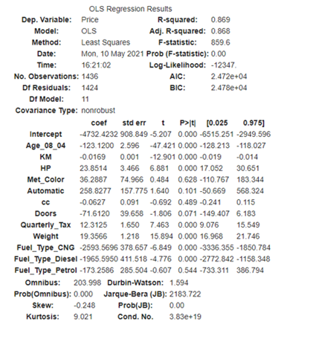
OUTPUT

Slide 25
Model Analysis
R Value - 0.8789 suggests a high positive correlation between the Original and Forecasted Prices.
R-Square value -The table value of 0.869 suggests that our linear regression model determines 86.9% of changes in the dependent variable, Price.
Adjusted R-squared compares the explanatory power of regression models that contain different numbers of predictors.
R-square change, which is just the improvement on R-square when the second predictor is added. The R-square change is tested with an F-test, which is referred to as the F-change.

Slide 26
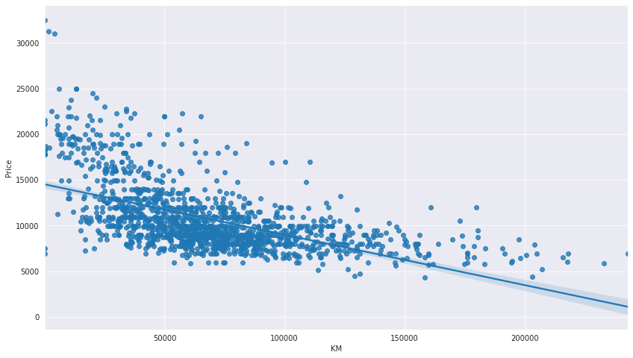
Regression Plot (Line of Best Fit):

Slide 27

Conclusion
Cars Priced above 300000 are unlikely to make a significant impact on the Prediction model.
The price would remain unaffected by whether the Car is painted with metallic colour.
Primarily, Age, Quarterly Tax, Weight, Kilometers covered, and HP were the primary factors deciding the price of the second hand car.
CNG was found out to be the additional fuel type for the car, where the primary fuel type was either Petrol or Diesel.

Slide 28

Business Implication
The car seller would not have to bother about car being of Petrol type (as Fuel Type Petrol is deemed insignificant).
The potential customer or the seller should keep in mind that number of doors don’t impact the car’s price.
Engine Capacity (cc) and Automatic transmission won’t drive the prices of second hand cars, primarily.
The Dealer should focus on cars with higher age, as it will fetch lower trade-off price.

Slide 29
Github Links
Aditya Singh Kashyap (02) – https://github.com/kashyapaditya256
Swastika Swastik (53) – https://github.com/swastika19

Slide 30


